Slide 1

Digital Electronics And Computer Architecture
Department of Computer Science and Engineering

Slide 2

Syllabus: Module 3
Sequential Logic Design:
1-bit Memory Cell, Flip flops, Conversion of flip flops, Design of ripple counters and synchronous counters, Modulus of the counter, Sequence generator, Lock out condition. Shift registers, Applications of Shift registers (ring and twisted ring counters), Moore and Mealy Models- State diagram, State Tables and Design Procedure, Sequence detector.

Slide 3

Difference between combinational and sequential logic
Sr. No. | Combinational Logic | Sequential Logic
1. | The output are all times depend on the combination of input variable. | The output is depend on present input as well depend on past history of input variable
2. | It does not use any memory | It has memory so output can vary based on input.
3. | It is easy to design | It is harder to design
4. | Faster | Slower

Slide 4
Difference between asynchronous and synchronous circuits
The SEQUENCIAL Circuit are classified in two main categories, known as Asynchronous and Synchronous.
Sequential circuit depending on timing of their signals.
Asynchronous Circuit: A sequential circuit whose behavior depends upon the sequence in which the input signal change is referred to as an asynchronous circuit.
Synchronous Circuit: A sequential circuit whose behavior can be defined from knowledge of its signal at discrete instants of time is referred to as a synchronous circuit.

Slide 5
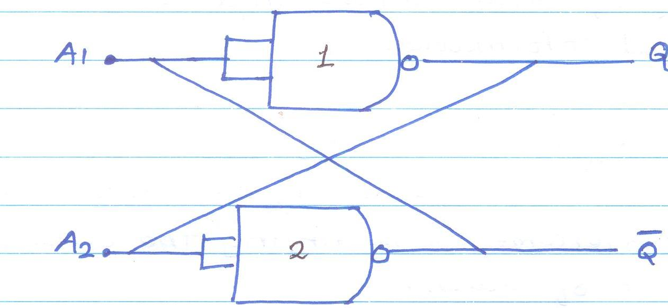
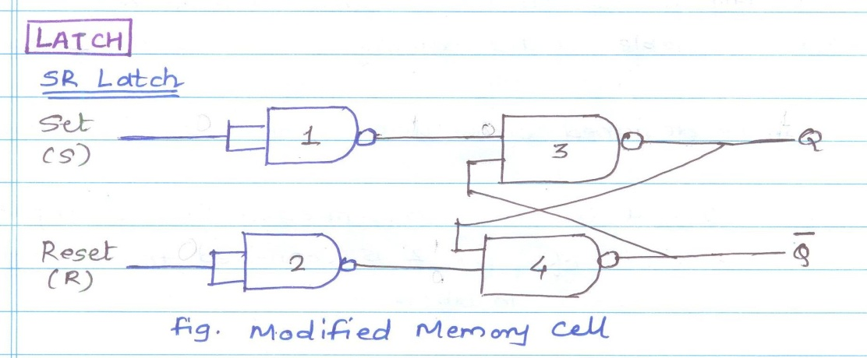
Sequential Logic
It has a memory element in the circuit that stores the result of the previous set of inputs and the current output depends on inputs in the past as well as present inputs.
The basic element in sequential logic is the bistable latch or flip-flop, which acts as a memory element for one bit of data.
One bit memory cell Latch
ONE BIT MEMORY CELL

Slide 6
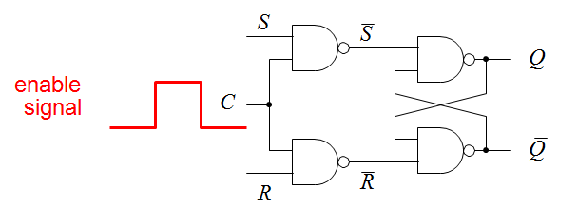
Flip Flops (The set–reset or SR Latch)
S | R | C(Clock) | Q(OUTPUT)
0 | 0 | 1 | Q(Previous State)
0 | 1 | 1 | 0
1 | 0 | 1 | 1
1 | 1 | 1 | *(indeterminate or ambiguous)
X | X | 0 | Q(Previous State)

Slide 7
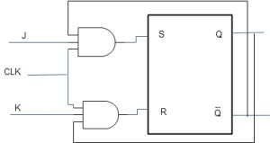
JK Flip Flop using SR Flip Flop

Slide 8
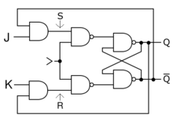
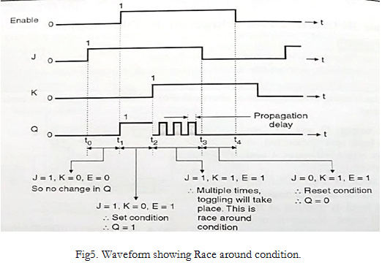
JK(Jack Kilby) Flip Flop

Slide 9
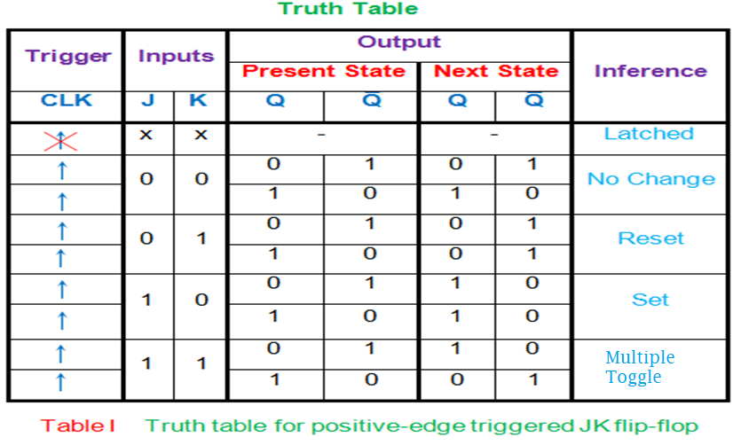
Truth Table of JK Flip Flop

Slide 10
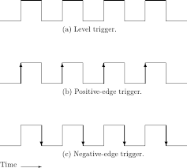
Level and Edge Triggering

Slide 11
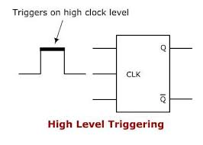
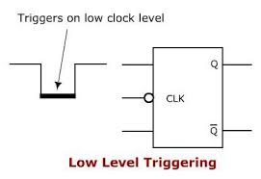
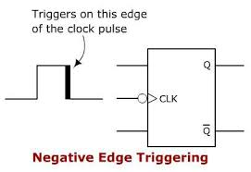
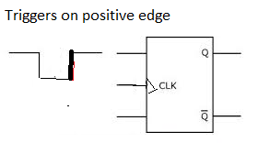
Level and Edge Triggering
Positive Edge triggering

Slide 12
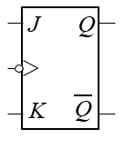
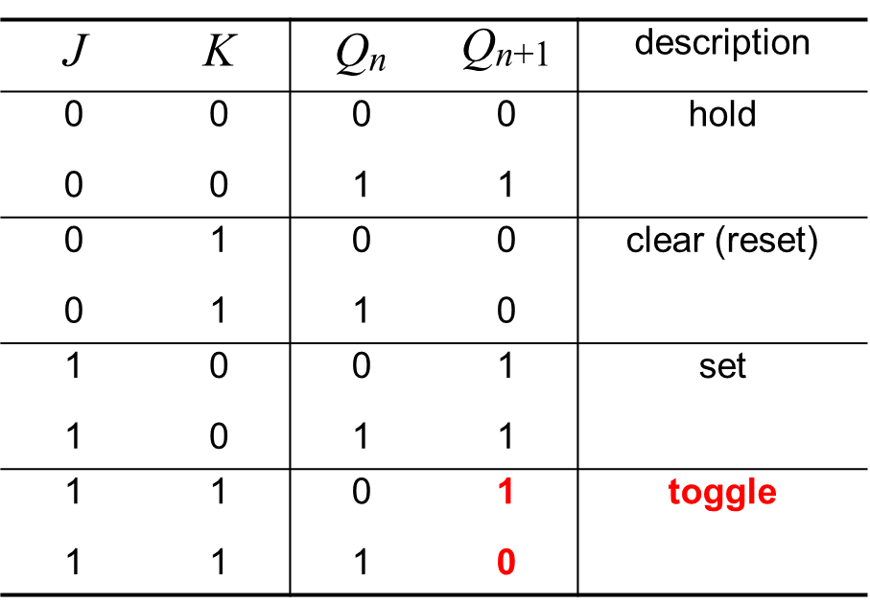
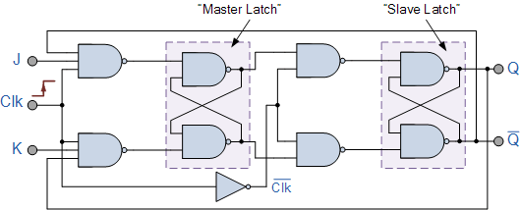
Master Slave JK FF

Slide 13
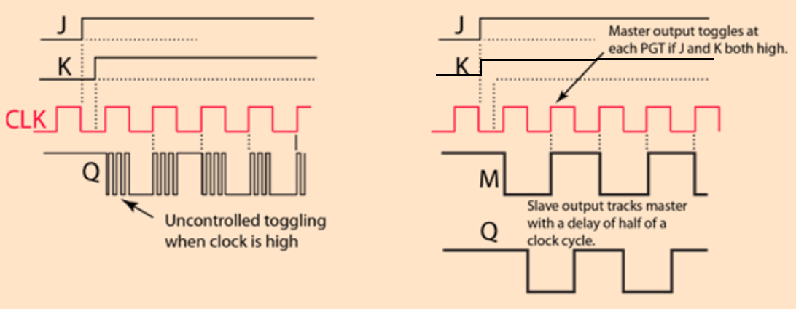
Comparison of JK and MS JK flip-flop
J K Flip Flop MS JK Flip Flop

Slide 14
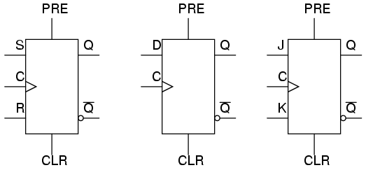
Flip Flops (An SR Flip-flop with Preset and Clear)
PRE | Clr | C | Q | Operation Performed
1 | 1 | 1 | Qn+1(SR) | Normal SR Flip flop
1 | 0 | 0 | 0 | Clear(reset)
0 | 1 | 0 | 1 | Preset(Set)
Notes:
Note: Asynchronous inputs on a flip-flop have control over the outputs (Q and not-Q) regardless of clock input status. These inputs are called the preset (PRE) and clear (CLR). The preset input drives the flip-flop to a set state while the clear input drives it to a reset state.

Slide 15
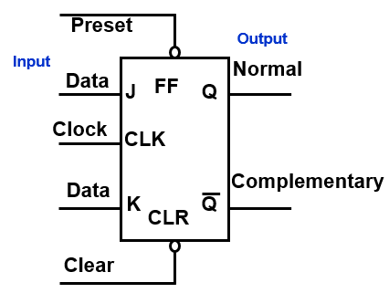
Usage of MS-JK Flip Flop: IC 7476
7476 uses the entire pulse to transfer data from J & K data inputs to Q & Q’ outputs.
It is a Universal Flip Flop. It has all features of other FF.
When being used only in the toggle mode, commonly called a T Flip Flop.
CMOS examples: 74HC76, 74AC109, 4027.
Most commonly used as counters.

Slide 16
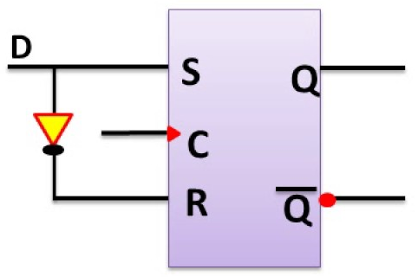
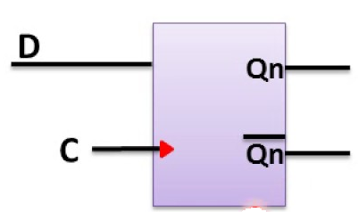
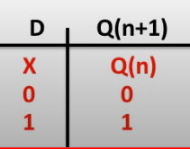
D Flip Flop: Truth Table and Symbol

Slide 17
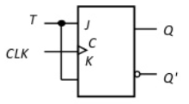
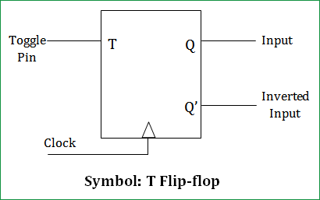
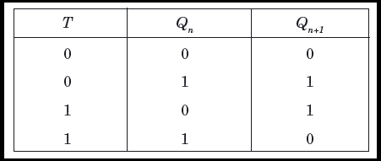
T Flip Flop: Truth Table and Symbol

Slide 18
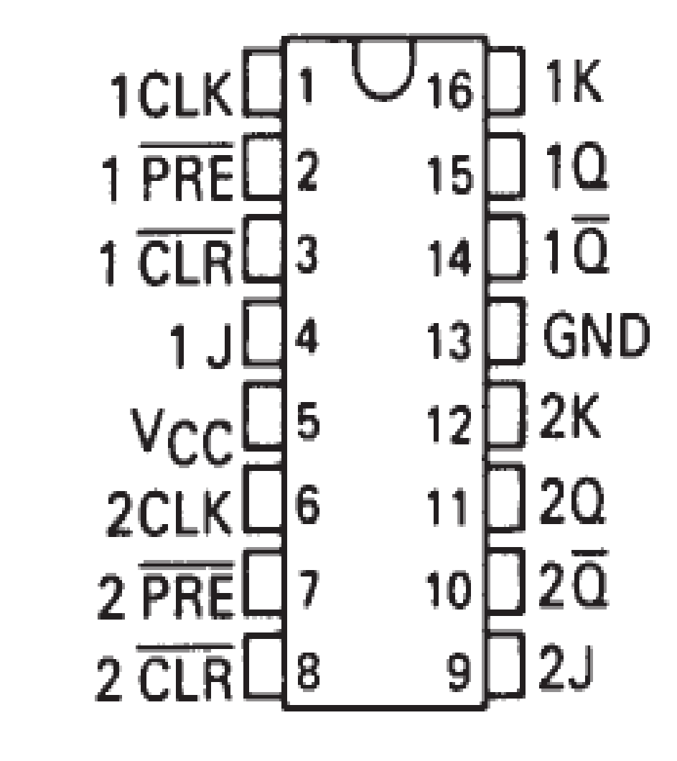
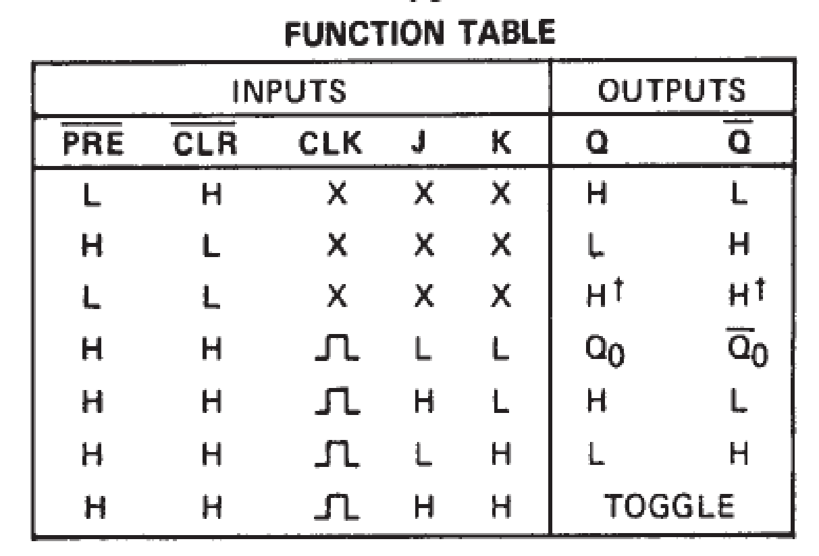
Study of IC7476(DUAL J-K FLIP-FLOPS WITH PRESET AND CLEAR)

Slide 19
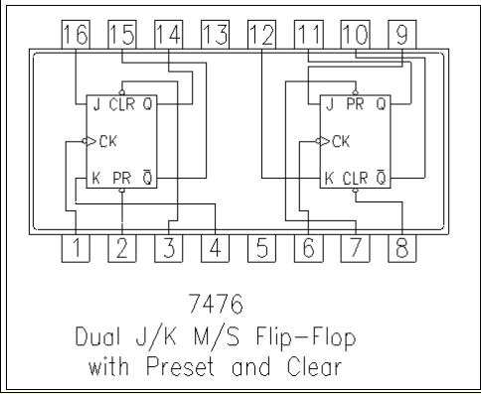
Study of IC 7476

Slide 20
Introduction to Flip-Flop Excitation Table
We have described flip-flop behavior by using a characterizes table which gives the new state as a function of the present state and inputs.
What we need if we know the state and inputs and was to determine the new state.
Sometimes, though, we know the state we are in and the state we wish to be in, and need to know the inputs required.
For this purpose, we can consult an excitation table

Slide 21
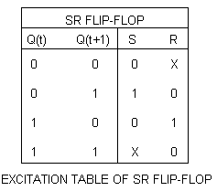
Important Definition
Characteristic Table: The truth table of flip flop is also referred to as characteristic table and it specifies the operational characterizes of flip-flop.
Excitation Table: In design of sequential circuit, present state and next state of the circuit are specifies.
Example: The output of SR flip-flop before clock pulse is Qn = 0 and it is desired that the output does not change when clock pulse is applied.
TRUTH TABLE EXCITATION TABLE
S | R | Qn+1
0 | 0 | Qn =0
0 | 1 | 0
1 | 0 | 1
1 | 1 | *
Notes:
Note: Above condition Qn+1 is satisfy when inputs are S= 0, R=0 and s=0 and r=1

Slide 22
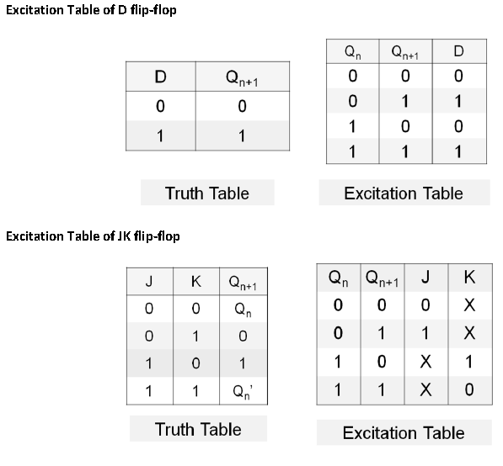
Excitation Table and Truth Table of Flip Flops

Slide 23
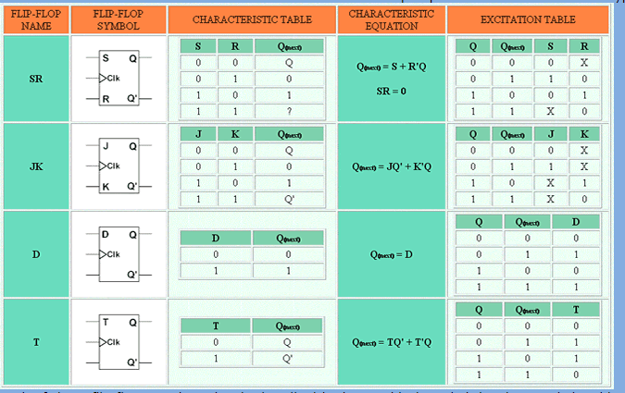
Excitation Table of Flip Flops

Slide 24
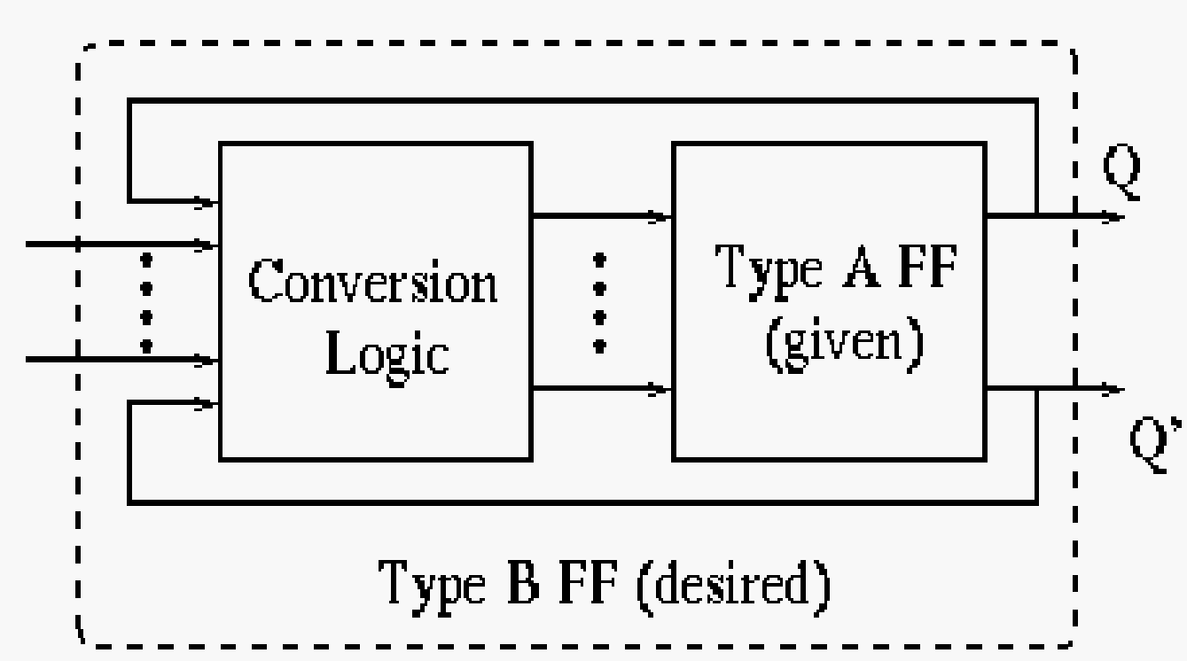
Conversion from one type to another type of Flip Flop

Slide 25
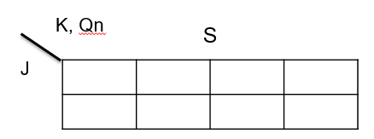
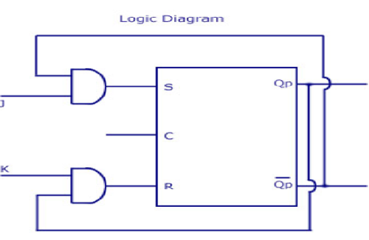
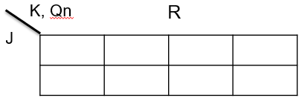
Convert SR to JK FF
Write the Excitation table of Available F/F(SR)
Write the Truth table of Required F/F (JK)
Prepare a table of inputs of required flip flop along with present state Qn (e.g. J,K and Qn) showing all the possible states
Add the column of next state Qn+1 considering inputs (J,K) and Qn
Add the column of inputs of available flip flops considering Qn and Qn+1. Use excitation table of available F/F
Solve k maps for inputs of available F/F (S,R) using inputs of required F/F and Qn as inputs (J, K, Qn)
J | K | Qn
0 | 0 | 0
0 | 0 | 1
0 | 1 | 0
0 | 1 | 1
1 | 0 | 0
1 | 0 | 1
1 | 1 | 0
1 | 1 | 1
S | R
Qn+1
0 | X
0
1
X | 0
0 | X
0
0 | 1
0
1 | 0
1
X | 0
1
1 | 0
1
0
0 | 1
0 | X | 0 | 0
1 | X | 0 | 1
X | 0 | 1 | X
0 | 0 | 1 | 0
S = J.Qn’
R = K.Qn

Slide 26
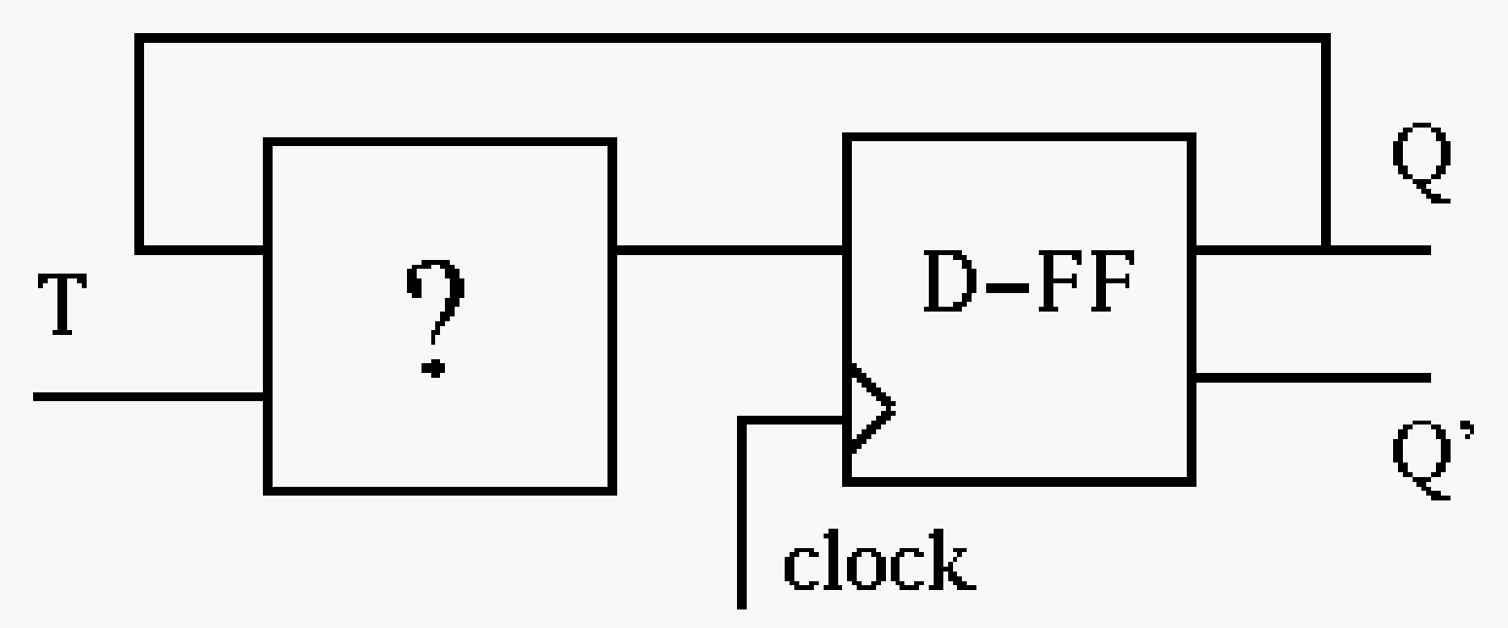
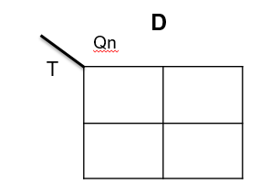

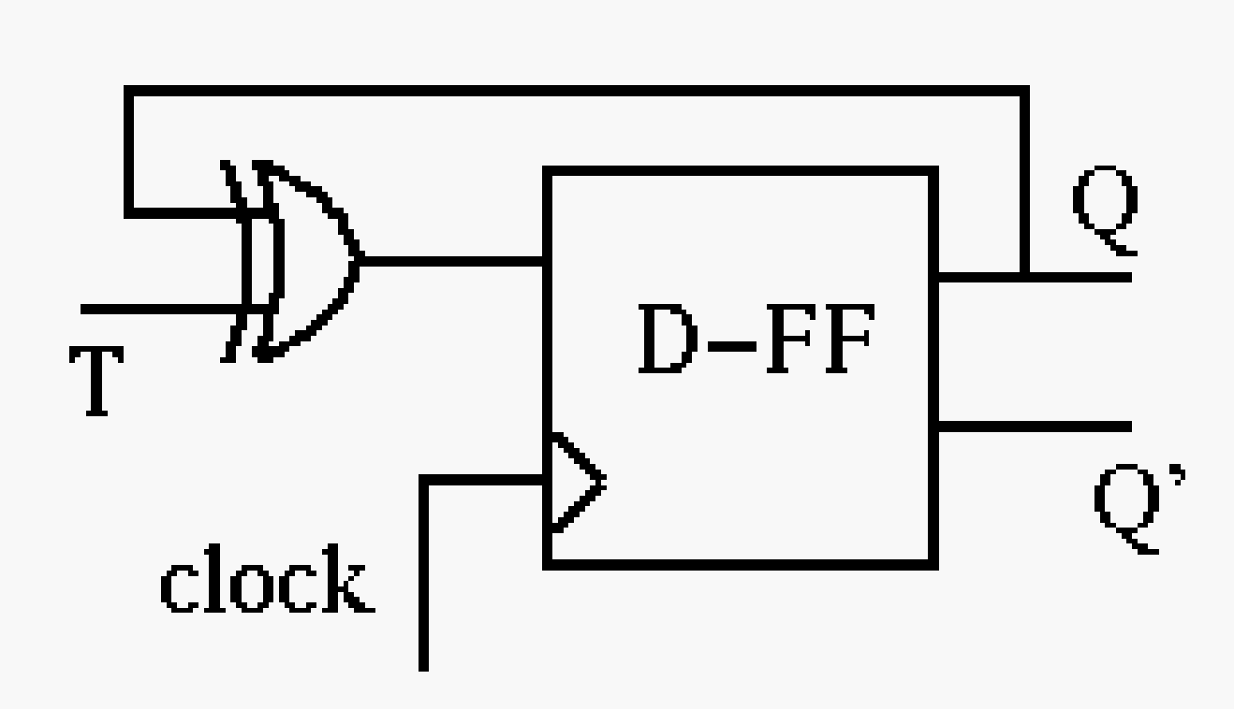
Convert D FF to T FF
Consider the excitation table of T and D Flip flops.
Write Down Excitation Table of T, Qn and Qn+1, D.
For the K-map, consider T and Qn as Input and D as output.
0 | 1
1 | 0
T | Qn
0 | 0
0 | 1
1 | 0
1 | 1
Qn+1
0
1
1
0
D
0
1
1
0

Slide 27
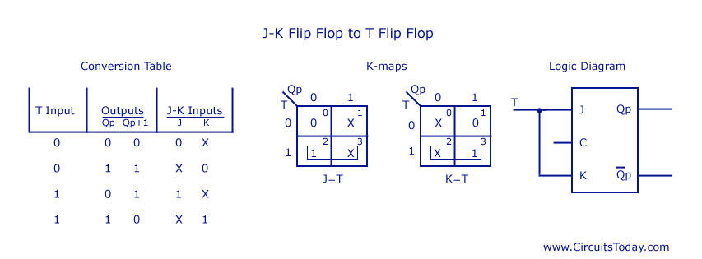
Convert JK FF to T FF

Slide 28
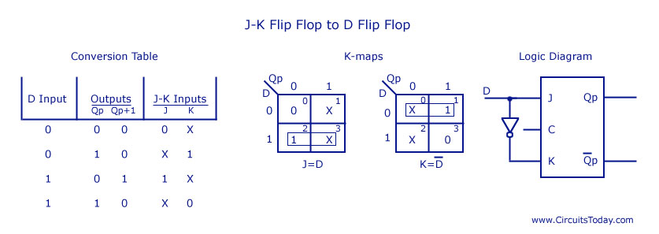
Convert JK FF to D FF

Slide 29
Counters
Counters are a specific type of sequential circuit.
The state, or the flip-flop values themselves, serves as the “output.”
The output value increases by one on each clock cycle.
After the largest value, the output “wraps around” back to 0.
Using two bits, we’d get something like that
1
00
01
1
1
1
11
10

Slide 30
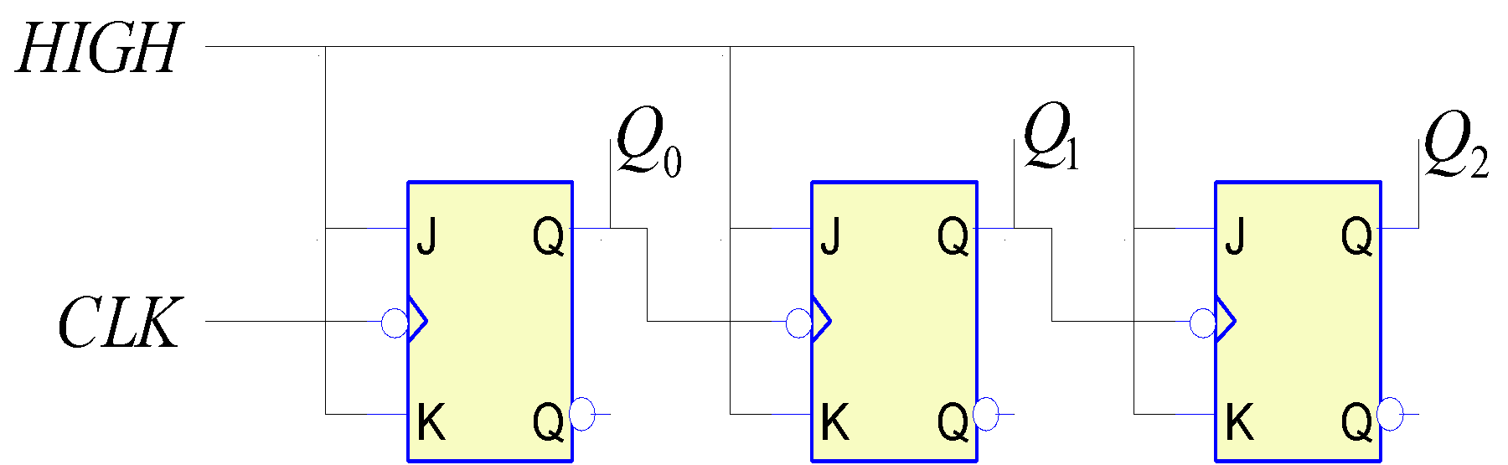
Asynchronous Counters
Only the first flip-flop is clocked by an external clock. All subsequent flip-flops are clocked by the output of the preceding flip-flop.
Asynchronous counters are also called ripple-counters because of the way the clock pulse ripples it way through the flip-flops.
The flip-flop output transition serves as a source for triggering other flip-flops

Slide 31
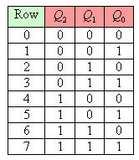
Counting in Binary
The binary counting sequence is shown on the right
Look at the column labelled Q₀. It reads 0, 1, 0, 1, 0, 1, etc. If this were drawn as a timing diagram, it would look like a clock. Assume that this clock has period T
Now look at the column labelled Q₁. It reads 0, 0, 1, 1, 0, 0, 1, 1. It looks like a clock too! However, it stays 0 twice as long, then 1 twice as long. In fact, it looks like a clock that has a period of 2T
Now look at the column labelled Q₂. It reads 0, 0, 0, 0, 1, 1, 1, 1. Again, this looks like a clock, except it's going twice as slow! It has a period of 4T!

Slide 32
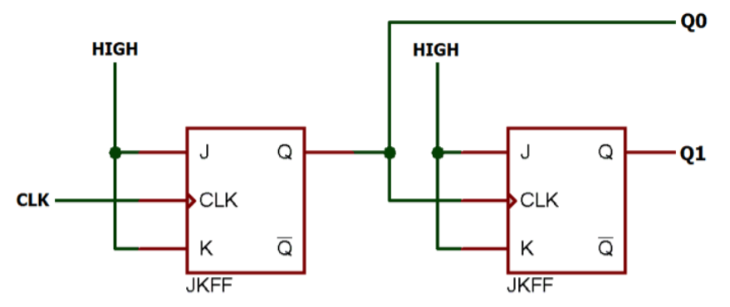
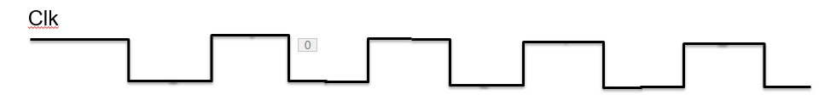
2 Bit Asynchronous UP Counter
J | K | Qn+1
0 | 0 | Qn
0 | 1 | 0
1 | 0 | 1
1 | 1 | Qn’
Q0
Q1

Slide 33
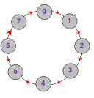
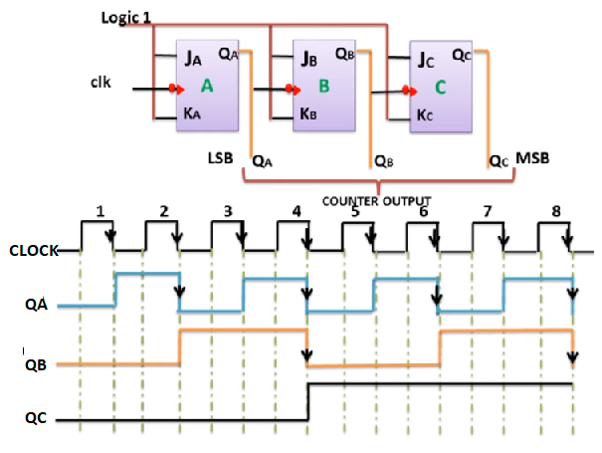
The Timing Diagram of 3 bit Asynchronous UP counter

Slide 34
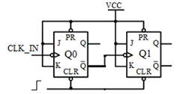
2 Bit Asynchronous Down Counter
Q1 | Q0
0 | 0
1 | 1
1 | 0
0 | 1
CLK
Q0
0
1
0
1
Q0
Q1
0
1
1
0
00
11
10
01

Slide 35
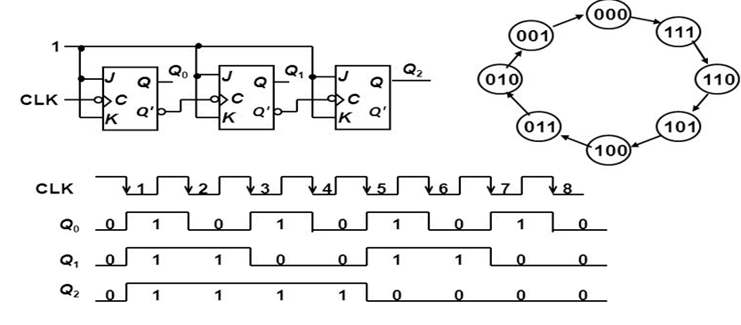
3 bit Asynchronous Down Counter

Slide 36
Modulus ‘n’ counter
The number of flip-flops determines the count limit or number of states. If N flip-flops are connected:
No. of states = 2^{N} where N = number of flip-flops
The number of states used is called the MODULUS
Modulus Counters, or simply MOD counters, are defined based on the number of states that the counter will sequence through before returning back to its original value
For example, a Modulus-12 counter (Mod-12) would count from 0 (0000₂) to 11 (1011₂) and would require four flip-flops (2⁴ = 16 states; 12 are used)

Slide 37
Modulus ‘n’ counter
Power-of-2 counters use all states
Example: 4-bit Binary / Hex / Mod-16 Counter
0000, 0001, 0010, … 1110, 1111, 0000, 0001, … all states used
Non-power-of-2 counters have extra, unused states
Example: 4-bit BCD / Decade / Mod-10 Counter
0000, 0001, 0010, … 1000, 1001, 0000, 0001, … six unused states

Slide 38
Feature of IC 7490 MOD
IC 7490 is a TTL MSI (medium scale integration) decade counter.
It is an asynchronous counter
It contains 4 master slave flip flops internally connected to provide MOD-2 i.e. divide by 2 and MOD-5 i.e. divide by 5 counters.
MOD-2 and Mod-5 counters can be used independently or in cascading.
It is a 4-bit ripple type decade counter.
It is also called as Divide by 10 counter as frequency at the MSB (QD) is 1/10*fclk

Slide 39
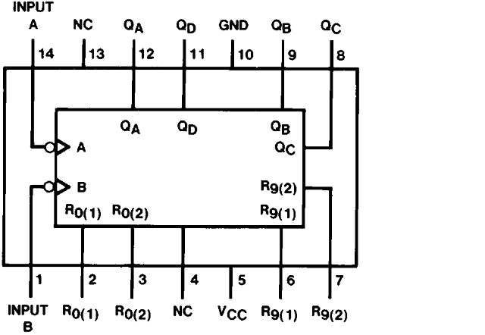
Pin Out of 7490

Slide 40
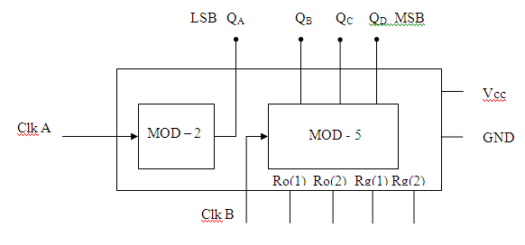
Internal Diagram of IC 7490

Slide 41
Function Table of MOD-2 and MOD - 5 counter
Function Table
Input B clock | Output |  |  | Count
 | QD | QC | QB
 | 0 | 0 | 0 | 0
 | 0 | 0 | 1 | 1
 | 0 | 1 | 0 | 2
 | 0 | 1 | 1 | 3
 | 1 | 0 | 0 | 4
Input A clock | Output QA | Count
 | 0 | 0
 | 1 | 1

Slide 42
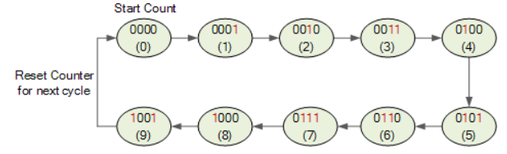
BCD Decade(MOD-10) Counter using IC 7490 State Diagram

Slide 43
Design of BCD Decade Counter using IC 7490
I/p clock | Output |  |  |  | Count
 | QD | QC | QB | QA
 | 0 | 0 | 0 | 0 | 0
 | 0 | 0 | 0 | 1 | 1
 | 0 | 0 | 1 | 0 | 2
 | 0 | 0 | 1 | 1 | 3
 | 0 | 1 | 0 | 0 | 4
 | 0 | 1 | 0 | 1 | 5
 | 0 | 1 | 1 | 0 | 6
 | 0 | 1 | 1 | 1 | 7
 | 1 | 0 | 0 | 0 | 8
 | 1 | 0 | 0 | 1 | 9
The QA o/p the first flip flop is connected to the input B which is clock i/p of internal MOD-5 ripple counter.
Due to cascading of Mod-2 and Mod-5 counters, the overall configuration is of a decade counters which counts from 0000 to 1001.
After 1001 mod-5 resets to 000 and mod 2 resets to 0. So next count after 1001 is 0000.

Slide 44

Timing diagram of mod10 Counter

Slide 45

Design of Mod-7 Counter using IC 7490
Construct MOD-10 counter and then truncate the count to 7 using RESET pins
Mod-7 counter counts through seven states from 0 to 6 It should reset as soon as the count becomes 7.
The o/p of reset logic should be 1 corresponding to invalid states.
The reset logic o/p should be applied to pin 2 and 3(RESET pins).
To design RESET logic, connect the outputs going one in first unwanted state (here 7) to input of AND gate and connect AND gate output to R01 and R02
QD | QC | QB | QA | Count | RESET I/P
0 | 0 | 0 | 0 | 0 | 0
0 | 0 | 0 | 1 | 1 | 0
0 | 0 | 1 | 0 | 2 | 0
0 | 0 | 1 | 1 | 3 | 0
0 | 1 | 0 | 0 | 4 | 0
0 | 1 | 0 | 1 | 5 | 0
0 | 1 | 1 | 0 | 6 | 0
0 | 1 | 1 | 1 | 7 | 1
1 | 0 | 0 | 0 | 8 | 1
1 | 0 | 0 | 1 | 9 | 1

Slide 46

Design of Mod-7 Counter using IC 7490

Slide 47

Cascading of IC 7490
To get the BCD counter which can count more than 10 pulses, cascading of IC 7490 is done.
Multiple ICs can be cascaded together to get required count.
Each cascaded IC is a decade counter ( QA connected to CLK B)
MSB output (QD) of first IC is connected as CLK A of second IC
Two cascaded ICs can count up to 100 states (0 to 99)
Three cascaded ICs can count up to 1000states (0 to 999) and so on

Slide 48
Design of Mod-100 Counter using IC 7490
The MOD-100 counter will count 100 states from 0 to 99.
One IC 7490 can count from 0 to 9.
For Mod-100 counter, two ICs of 7490 will be required. One for Unit’s place and one for Ten's place
Cascading two BCD counters in such a way that after the Unit’s place IC counts from 0 to 9, ten’s place IC will increment once will suffice the requirement.
No separate reset logic is required

Slide 49

Design of Mod-100 Counter using IC 7490
MSB
Input B
Input B
R1 = R0 1
R2 = R0 2
S1 = R9 1
S2 = R9 2
Clock input
Unit’s Place
Ten’s Place
As input clock is given to Unit Place IC, it will count from 0 to 9.
When QD of IC 1 will go from 1 to 0 in next clock pulse, IC 2 will get clock at its input A and second IC will count 1.
Second IC will get clock only when first IC will count from 0 to 9 (i.e. after every 10 clock pulses).
Thus the counter will reach to 99 before resetting to 00

Slide 50

MOD 20 Counter
In MOD 20 Counter, states will be from 00 to 19.
The counter should get reset when it will try to go to state 20
So design a resetting logic by considering the pins which are at logic 1 when count will be 20
Connect the output of the reset logic to RESET input pins R0 1, R0 2 of both the Ics
As in only QB pin will be high in count 20, connecting it to reset pins will suffice the purpose.

Slide 51

MOD 96 Counter
In MOD 96 Counter, states will be from 00 to 95.
The counter should get reset when it will try to go to state 96
So design a resetting logic by considering the pins which are at logic 1 when count will be 96
Connect the output of the reset logic to RESET input pins R0 1, R0 2 of both the ICs

Slide 52

Design of Mod-99 using IC 7490
In MOD 99 Counter, states will be from 00 to 98.
The counter should get reset when it will try to go to state 98
So design a resetting logic by considering the pins which are at logic 1 when count will be 98
Connect the output of the reset logic to RESET input pins R0 1, R0 2 of both the ICs

Slide 53

Build a 3-bit Synchronous Up Counter
A synchronous counter, in contrast to an asynchronous counter, is one whose output bits change state simultaneously, with no ripple
The only way we can build such a counter circuit from J-K flip-flops is to connect all the clock inputs together, so that each and every flip-flop receives the exact same clock pulse at the exact same time

Slide 54

Build a 3-bit Synchronous Up Counter
Draw the state diagram for the given counter
Identify the number of flip flops required
Write the state table using Excitation table of the flip flop
Find the equation for each input of flip flop using K Map simplification technique
Connect the circuit by connecting the inputs as per the equations obtained and connect clock inputs of all the flip flops to main clock input

Slide 55

3 Bit Synchronous Counter(State Table)
No | Present State |  |  | Next State |  |  | Flip Flop Inputs
 | Q₂ | Q₁ | Q₀ | Q₂₊₁ | Q₁₊₁ | Q₀₊₁ | J₂ | K₂ | J₁ | K₁ | J₀ | K₀
0 | 0 | 0 | 0 | 0 | 0 | 1 | 0 | X | 0 | X | 1 | X
1 | 0 | 0 | 1 | 0 | 1 | 0 | 0 | X | 1 | X | X | 1
2 | 0 | 1 | 0 | 0 | 1 | 1 | 0 | X | X | 0 | 1 | X
3 | 0 | 1 | 1 | 1 | 0 | 0 | 1 | X | X | 1 | X | 1
4 | 1 | 0 | 0 | 1 | 0 | 1 | X | 0 | 0 | X | 1 | X
5 | 1 | 0 | 1 | 1 | 1 | 0 | X | 0 | 1 | X | X | 1
6 | 1 | 1 | 0 | 1 | 1 | 1 | X | 0 | X | 0 | 1 | X
7 | 1 | 1 | 1 | 0 | 0 | 0 | X | 1 | X | 1 | X | 1
0
7
1
6
2
5
3
4

Slide 56

3 Bit Synchronous Counter(State Table)
0
7
1
6
2
5
3
4

Slide 57

Simplification using K- MAP
Q1Q0 Q2 | 00 | 01 | 11 | 10
0 | 0 | 0 | 1 | 0
1 | X | X | X | X
Q1Q0 Q2 | 00 | 01 | 11 | 10
0 | X | X | X | X
1 | 0 | 0 | 1 | 0
K₂ = Q1Q0
J₂ = Q1Q0

Slide 58

Simplification using K- MAP
Q1Q0 Q2 | 00 | 01 | 11 | 10
0 | 0 | 1 | X | X
1 | 0 | 1 | X | X
Q1Q0 Q2 | 00 | 01 | 11 | 10
0 | X | X | 1 | 0
1 | X | X | 1 | 0
J₁ = Q0
K₁ = Q0

Slide 59

Simplification using K- MAP
Q1Q0 Q2 | 00 | 01 | 11 | 10
0 | 1 | X | X | 1
1 | 1 | X | X | 1
Q1Q0 Q2 | 00 | 01 | 11 | 10
0 | X | 1 | 1 | X
1 | X | 1 | 1 | X
J₀ = 1
K₀ = 1

Slide 60

3 bit Synchronous UP Counter

Slide 61

3 bit Synchronous down counter( State Table)
Present state |  |  | Next state |  |  | Flip flop 3 |  | Flip flop 2 |  | Flip flop 1
Q2 | Q1 | Q0 | Q2 | Q1 | Q0 | J2 | K2 | J1 | K1 | J0 | K0
1 | 1 | 1 | 1 | 1 | 0 | X | 0 | X | 0 | X | 1
1 | 1 | 0 | 1 | 0 | 1 | X | 0 | X | 1 | 1 | X
1 | 0 | 1 | 1 | 0 | 0 | X | 0 | 0 | X | X | 1
1 | 0 | 0 | 0 | 1 | 1 | X | 1 | 1 | X | 1 | X
0 | 1 | 1 | 0 | 1 | 0 | 0 | X | X | 0 | X | 1
0 | 1 | 0 | 0 | 0 | 1 | 0 | X | X | 1 | 1 | X
0 | 0 | 1 | 0 | 0 | 0 | 0 | X | 0 | X | X | 1
0 | 0 | 0 | 1 | 1 | 1 | 1 | X | 1 | X | 1 | X

Slide 62
3 bit Synchronous down counter( State Table)
Present state |  |  | Next state |  |  | Flip flop 3 |  | Flip flop 2 |  | Flip flop 1
Q2 | Q1 | Q0 | Q2 | Q1 | Q0 | J2 | K2 | J1 | K1 | J0 | K0
1 | 1 | 1 | 1 | 1 | 0 | X | 0 | X | 0 | X | 1
1 | 1 | 0 | 1 | 0 | 1 | X | 0 | X | 1 | 1 | X
1 | 0 | 1 | 1 | 0 | 0 | X | 0 | 0 | X | X | 1
1 | 0 | 0 | 0 | 1 | 1 | X | 1 | 1 | X | 1 | X
0 | 1 | 1 | 0 | 1 | 0 | 0 | X | X | 0 | X | 1
0 | 1 | 0 | 0 | 0 | 1 | 0 | X | X | 1 | 1 | X
0 | 0 | 1 | 0 | 0 | 0 | 0 | X | 0 | X | X | 1
0 | 0 | 0 | 1 | 1 | 1 | 1 | X | 1 | X | 1 | X
7
6
5
4
3
2
1
0

Slide 63






Simplification using K- MAP for J2,K2,J1,K1,J0,K0
J2 =Q1’Q0’
K2 = Q1’Q0’
J1 =Q0’
K1 =Q0’
J0 = 1
K0 =1

Slide 64

3 bit Synchronous down counter

Slide 65


Comparison of Counters
Asynchronous/Ripple Counter
Flip flops are connected in such a way that the o/p of first flip-flop drives the clock of next flip-flop.
Flip-flops are not clocked simultaneously.
Circuit is simple for more number of states.
Speed is slow as clock is propagated through number of stages.
Asynchronous Counter are also known as “Ripple Counter” because of the way the clock pulses or ripples, its way through the flip-flop.
Synchronous Counter
There is no connection between o/p of first flip-flop and clock of next flip-flop.
Flip-flops are clocked simultaneously.
Circuit becomes complicated as number of states increases.
Speed is high as clock is given at a same time.

Slide 66

Design of sequence generator
Definition: A sequence generator is one kind of digital logic circuit. The main function of this is to generate a set of outputs.
A special kind of sequence generator is a binary counter.
The sequence generator circuit is used to generate a prescribed series of bits in synchronization through a CLK.
We have seen a sequence generator using shift register in previous unit
We will study design of sequence generator using counter type circuit here!

Slide 67
Design of sequence generator
The sequence generator can be classified as
Sequence generator without bushing (Not taking care of unwanted states)
Sequence generator with bushing (Taking care of unwanted states)
Step 1
To find number of flip flops required,
Find the no. of 1‘s in the sequence.
Find the no. of 0‘s in the sequence.
Take the maximum out of two.
If ‘n’ is the required no. of flip flops, choose minimum value of ’n’ to satisfy equation given below.

Slide 68
Design of sequence generator
Step 2:
Once the no. of flip flops are decided assign unique states corresponding to each bit in the given sequence.
Copy the given sequence in the column under the LSB output
Usually the o/p of flip flop representing the least significant bit is used to generate the given sequence but any other flip flop in the circuit also can be used to give the output.
Step 3:
Draw a state diagram for states
Step 4:
Prepare a state table using excitation table of the flip flop
Step 5:
Prepare and solve K Maps for inputs of flip flops (e.g. J2, K2, J1, K1 etc)
Step 6:
Draw the circuit diagram

Slide 69


Example: Design a sequence generator for sequence 10101 (Without Bushing) Ex. 10110
Step 1
Design a sequence generator to generate a sequence of bit 10101.
For finding the no. of flip flops we use the formula
where m= maximum count of 0s and 1s
n= no. of flip flops required.
Here, No. of 1s = 3, No. of 0s = 2 Hence M= 3
3 Hence, n = 3

Slide 70

Design of sequence generator : Step 2
For the given sequence 10101, we know 3 flip flops are required. Lets call the flip flops as FF2,FF1,and FF0 with the corresponding outputs Q2, Q1 and Q0
Copy the given sequence in Q0 column
Fill the values in column of Q2 and Q1 in such a way that no state repeats to prepare a truth table
Step 3
Prepare a state diagram (Without Bushing)
Q2 | Q1 | Q0 | State Assigned
0 | 0 | 1 | 1
 |  | 0
 |  | 1
 |  | 0
 |  | 1
Q2 | Q1 | Q0 | State Assigned
0 | 0 | 1 | 1
0 | 0 | 0 | 0
 |  | 1
 |  | 0
 |  | 1
Q2 | Q1 | Q0 | State Assigned
0 | 0 | 1 | 1
0 | 0 | 0 | 0
0 | 1 | 1 | 3
0 | 1 | 0 | 2
1 | 0 | 1 | 5
Q2 | Q1 | Q0 | State Assigned
 |  | 1
 |  | 0
 |  | 1
 |  | 0
 |  | 1
Q2 | Q1 | Q0 | State Assigned
Q2 | Q1 | Q0 | State Assigned
0 | 0 | 1 | 1
0 | 0 | 0 | 0
0 | 1 | 1 | 3
 |  | 0
 |  | 1
Q2 | Q1 | Q0 | State Assigned
0 | 0 | 1 | 1
0 | 0 | 0 | 0
0 | 1 | 1 | 3
0 | 1 | 0 | 2
 |  | 1

Slide 71
Design of sequence generator : Step 3
Prepare a state table using state diagram. Consider all the possible states as present state. Write Don’t care condition (X) as a next state for states not present in the state diagram.
Present State |  |  | Next State
Q2 | Q1 | Q0 | Q2 | Q1 | Q0
Present State |  |  | Next State
Q2 | Q1 | Q0 | Q2 | Q1 | Q0
0 | 0 | 0 | 0 | 1 | 1
0 | 0 | 1 | 0 | 0 | 0
0 | 1 | 0
0 | 1 | 1
1 | 0 | 0
1 | 0 | 1
1 | 1 | 0
1 | 1 | 1
Present State |  |  | Next State
Q2 | Q1 | Q0 | Q2 | Q1 | Q0
0 | 0 | 0 | 0 | 1 | 1
0 | 0 | 1
0 | 1 | 0
0 | 1 | 1
1 | 0 | 0
1 | 0 | 1
1 | 1 | 0
1 | 1 | 1
0 | 0 | 0
0 | 0 | 1
0 | 1 | 0
0 | 1 | 1
1 | 0 | 0
1 | 0 | 1
1 | 1 | 0
1 | 1 | 1
0 | 1 | 0 | 1 | 0 | 1
0 | 1 | 1 | 0 | 1 | 0
1 | 0 | 0 | X | X | X
1 | 0 | 1 | 0 | 0 | 1
1 | 1 | 0 | X | X | X
1 | 1 | 1 | X | X | X

Slide 72


Design of sequence generator : Step 3
Complete the state table using Excitation table of flip flop

Slide 73






Design of sequence generator : Step 4 K Maps
00 01 11 10
00 01 11 10
00 01 11 10
0
1
0
1
0
1
J1 = Q2’
J2 = Q1Q0’
J0 = 1
00 01 11 10
00 01 11 10
00 01 11 10
0
1
0
1
0
1
K0 = Q2’
K1 = Q0’
K2 = 1

Slide 74

Design of sequence generator : Step 5 Circuit Diagram
CLK
VCC

Slide 75


Design of sequence generator : With Bushing
In the given example, (sequence 10101 ) as we have three flip flops, maximum 8 states can be generated. Out of eight, 5 states (1,0,3,2,5) are wanted states where as remaining 3 states (4,6,7) are unwanted states.
Lock out condition will occur if circuit enters in any unwanted state and keeps on moving in unwanted states.
With bushing, design takes care of these unwanted or unassigned states by connecting them to one of the valid state to avoid lock out condition
State diagram
(With Bushing)
State diagram
(Without Bushing)
State diagram
(Lockout Condition)

Slide 76
Design of sequence generator : With Bushing
Q2 | Q1 | Q0 | State Assigned
0 | 0 | 1 | 1
0 | 0 | 0 | 0
0 | 1 | 1 | 3
0 | 1 | 0 | 2
1 | 0 | 1 | 5
State diagram
(Without Bushing)
State diagram
(With Bushing)
The unwanted states can be connected to any wanted state.
Unwanted states are shown connected to state 0 as an example.
The three unwanted states can be connected to three different wanted states.
Remaining steps are same as that followed in sequence generator without bushing.

Slide 77

Design of sequence generator : Step 3
Prepare a state table using Excitation table of flip flop
Unwanted states 4,6,7

Slide 78






Design of sequence generator : Step 4 K Maps
J0 = Q2’
J1 = Q2’Q0’
J2 = Q1Q0’
K0 = Q2’ + Q1
K1 = Q2 + Q0’
K2 = 1

Slide 79

Design of sequence generator : Step 5 Circuit Diagram

Slide 80
Registers
A register is a collection of flip-flops that act as an extension of a flip-flop which can store multiple bits
It has two basic functions: Data Storage and Data Movement
A shift register provides the data movement function where it is capable of shifting their binary contents in one or both directions (shifting data to the left or right)
It “shifts” its output once every clock cycle

Slide 81
Buffer Register
Buffer registers are a type of registers used to store a binary word.
These can be constructed using a series of flip-flops as each flip-flop can store a single bit.
This means that in order to store an n-bit binary word one should design an array of n flip-flops. Figure 1 shows a 4 bit synchronous buffer register formed by cascading four positive edge triggered D flip-flops.
Here the entire input data word B₁B₂B₃B₄ is loaded onto the register at a single clock tick. This means that at every leading edge of the clock the values of flip-flop outputs follow their input bits i.e. Q₁ = B₁, Q₂ = B₂, Q₃ = B₃ and Q₄ = B₄ as shown by Figure 2.

Slide 82


Buffer Register

Slide 83

Shift Registers
A shift register "shifts" its output once every clock cycle
Q₀(t+1) = SI
Q₁(t+1) = Q₀(t)
Q₂(t+1) = Q₁(t)
Q₃(t+1) = Q₂(t)
SI is an input that supplies a new bit to shift "into" the register
For example, if on some positive clock edge we have:
SI = 1
Q₀-Q₃ = 0110 then the next state will be:
Q₀-Q₃ = 1011
The current Q₃ (0 in this example) will be lost on the next cycle

Slide 84

Basic Shift Register Operation
Some basic data movements are illustrated here:
Data in
Data in
Data out
Data out
Data in
Serial in/shift right/serial out
Serial in/shift left/serial out
Parallel in/serial out
Data in
Data in
Data out
Data out
Serial in/parallel out
Parallel in/parallel out
Rotate right
Rotate left

Slide 85

Serial In - Serial Out Shift Registers
The serial in/serial out shift register accepts data serially –
The register is first cleared, forcing all four outputs to zero.
The input data is then applied sequentially to the D input of the first flip-flop on the left (FF0).
During each clock pulse, one bit is transmitted from left to right.

Slide 86
Serial In - Serial Out Shift Registers
A basic four-bit shift register can be constructed using four D flip-flops, as shown in Figure .
The operation of the circuit is as follows.
Assume a data word to be 1001.
The least significant bit of the data has to be shifted through the register from FF0 to FF3.

Slide 87


Serial In - Parallel Out Shift Registers
For this kind of register, data bits are entered serially in the same manner as discussed in the previous section.
The difference is the way in which the data bits are taken out of the register.
Once the data are stored, each bit appears on its respective output line, and all bits are available simultaneously.
For this kind of register, data bits are entered serially in the same manner as discussed in the previous section.
The difference is the way in which the data bits are taken out of the register.
Once the data are stored, each bit appears on its respective output line, and all bits are available simultaneously.
FF0 FF1 FF2 FF3

Slide 88

Parallel In - Parallel Out Shift Registers
For parallel in - parallel out shift registers, all data bits appear on the parallel outputs immediately following the simultaneous entry of the data bits.
The following circuit is a four-bit parallel in - parallel out shift register constructed by D flip-flops.

Slide 89

Parallel In - Serial Out Shift Registers
D0, D1, D2 and D3 are the parallel inputs, where D0 is the most significant bit and D3 is the least significant bit.
To write data in, the mode control line is taken to LOW and the data is clocked in.
The data can be shifted when the mode control line is HIGH as SHIFT is active high.
The register performs right shift operation on the application of a clock pulse.

Slide 90




Basic Shift Register Operation and Applications
Serial in Serial Out Shift Register (SISO) The main use of a SISO is to act as a delay element.
Serial in Parallel Out shift register (SIPO) The main application of Serial in Parallel out shift register is to convert serial data into parallel data. Hence they are used in communication lines where de-multiplexing of a data line into several parallel line is required.
Parallel in Serial out shift register (PISO) A Parallel in Serial out (PISO) shift register converts parallel data to serial data. Hence they are used in communication lines where a number of data lines are multiplexed into single serial data line.
Parallel in Parallel out shift register (PIPO) A Parallel in Parallel out (PIPO) shift register is used as a temporary storage device and also as a delay element similar to a SISO shift register.

Slide 91

Ring Counter
Ring counters are implemented using shift registers.
It is essentially a circulating shift register connected so that the last flip-flop shifts its value into the first flip-flop.
There is usually only a single 1 circulating in the register, as long as clock pulses are applied. (Starts 1000->0100->0010->0001 repeat)

Slide 92


Ring Counter

Slide 93

States in Ring counter: Example
Disadvantage: If all the outputs are 0 at the beginning then output does not change.
At least one output has to be made 1 before clock is started.

Slide 94

Johnson Counter
In Ring counter if all the outputs are zero at the beginning then output constantly remains zero.
To avoid this problem Johnson counter was introduced. It is also known as the twisted-ring counter.
It is exactly the same as the ring counter except that the inverted output of the last flip-flop is connected to the input of the first flip-flop.

Slide 95
Johnson Counter
 | Input DA = QD' | QA | QB | QC | QD
PS | 1 | 0 | 0 | 0 | 0
CLK | 1 | 1 | 0 | 0 | 0
CLK | 1 | 1 | 1 | 0 | 0
CLK | 1 | 1 | 1 | 1 | 0
CLK | 0 | 1 | 1 | 1 | 1
CLK | 0 | 0 | 1 | 1 | 1
CLK | 0 | 0 | 0 | 1 | 1
CLK | 0 | 0 | 0 | 0 | 1
CLK | 1 | 0 | 0 | 0 | 0
CLK | 1 | 1 | 0 | 0 | 0
CLK | 1 | 1 | 1 | 0 | 0
CLK | 1 | 1 | 1 | 1 | 0
CLK | 0 | 1 | 1 | 1 | 1
CLK | 0 | 0 | 1 | 1 | 1
CLK | 0 | 0 | 0 | 1 | 1
 |  | 0 | 0 | 0 | 1
Unique states= 8
Unique states = 2 * Number of flip flops
Sequence Repeats
Advantage: No need to insert single 1.
Number of unique states obtained are double the states obtained with Ring counter

Slide 96





Complex sequential circuits - Applications

Slide 97
Complex sequential circuits – An Example
Any Vending machine is an example of state machine and have:
Different States
Dispensing product, accept money, dispense change, error, Jam, initial stage
Sequential traversing between states
For orderly traversal, control sequencing, next state decoding and branching to next state is required

Slide 98
Introduction to Synchronous Sequential Circuit Design
A state machine is a digital device that traverses through a predetermined sequence of states in an orderly fashion
A state is a set of values measured at different parts of the circuit.
A simple state machine can consist of PAL device based combinatorial logic, output registers, and buried (state) registers.
State machine designs are widely used for sequential control logic, which forms the core of many digital systems

Slide 99
Introduction to Synchronous Sequential Circuit Design contd.
Sequential Circuits with finite number of states are called as Finite State Machines (FSM)
Different ways to express the FSMs w.r.t outputs:
Moore Machines - Sequential circuits in which outputs are function of only present state
Mealy Machines - Sequential circuits in which outputs are function of present state as well as input
Moore Machines
Mealy Machines

Slide 100

Block Diagram of a Simple State Machine
In addition to the device inputs and outputs, a state machine consists of two essential elements: combinatorial logic and memory (registers)
The memory is used to store the state of the machine
The combinatorial logic can be viewed as two distinct functional blocks: the next state decoder and the output decoder
The next state decoder determines the next state of the state machine while the output decoder generates the actual outputs
Although Combinational logic perform two distinct functions, these are usually combined into one combinatorial logic array

Slide 101
Operation of a state machine
The basic operation of a state machine is two fold:
It traverses through a sequence of states, where the next state is determined by next state decoder, depending upon the present state and input conditions.
It provides sequences of output signals based upon state transitions. The outputs are generated by the output decoder based upon present state and input conditions.
Control sequencing: The transitions from one state to another.
Transition function: The logic required for deciding the next states
Branching: deciding the next state using input signals.

Slide 102
State Machine Applications
State machines are used in a number of system control applications
In DSP: As sequencers for digital signal processing (DSP) applications, state machines offer speed and sufficient functionality without the overkill of complex microprocessors
In video controller: It generates addresses for scanning purposes, using counters with various sequences and lengths
In peripheral control: Both encoding and decoding can be translated into state machines, which examine the serial data stream as it is read, and generate the output data
Industrial control and robotics: Mechanical positioning of a robot arm, simple decision making, and calculation of a trigonometric function
Data encryption and decryption: A programmable state machine device with a security Bit is ideal for this because memory is internally programmed and cannot be accessed by someone tampering with the system

Slide 103

Finite State Machines
Sequential Circuits with finite number of states are called as Finite State Machines (FSM)
Those parts of digital systems whose outputs depend on their past inputs as well as their current ones can be modeled as finite state machines.
When a new input is presented to the FSM, an output is generated which depends on this input and the present state of the FSM, and the machine is caused to move into new state, referred to as the next state
The internal state is stored in a block labeled “memory.”

Slide 104
Types of FSMs
There are two different ways to express the FSMs with respect to the output.
Sequential circuits in which outputs are function of only present state are called Moore Machines
Sequential circuits in which outputs are function of present state as well as input are called Mealy Machines
For either type, the control sequencing depends upon both states and input signals

Slide 105

Moore machines
Moore machine
Outputs are a function
of current state
Outputs change
synchronously with state changes

Slide 106

Mealy machine
Mealy machine
Outputs depend on state and on inputs
Input changes can cause immediate output changes

Slide 107


Moore versus Mealy machines
Moore machine
Outputs are a function
of current state
Outputs change
synchronously with
state changes
Mealy machine
Outputs depend on state
and on inputs
Input changes can cause immediate output changes

Slide 108

Example Moore Machine

Slide 109

Example of Mealy Machine
If A = 0 then out = 0

Slide 110


State diagram notations: Moore machine
Each state is labeled by a pair: state-name / output or state-name [output]

Slide 111
State diagram notations: Moore machine
Each state is labeled by a pair: state-name / output or state-name [output]

Slide 112

State diagram notations: Mealy machine
Each transition arc is labeled by a pair:
input-condition / output

Slide 113

Comparison Mealy Machine with Moore Machine

Slide 114
Sequence detector circuit
To detect the start of the transmission or detection of sender etc, it is required to detect some specific sequence of 1s and 0s.
Sequence detector is a circuit whose output becomes 1 whenever the specified sequence is detected.
The sequence can be considered as overlapped or non overlapped.
Example: Let us detect sequence 010.
Z1 is the output if overlapping condition is considered and
Z2 is output if sequence is considered in non overlapped mode.
X is the input sequence received
Z1 =
0
0
0
0
0
0
1
0
1
0
0
Overlapping
Z2 =
0
0
0
0
0
0
1
0
0
1
0
Non Overlapping

Slide 115


Sequence detector for the sequence 101 using both Mealy and Moore Machine
Moore Machine
Mealy Machine

Slide 116











Sequence detector for the sequence 101 using Moore Machine
Sequence: 101; Length of sequence = 3 bits; No. of states = 4; State Names: S0, S1, S2, S3
Initial Stage = S0 [S0/0]
At S0 --On occurrence of 1; make transition to S1
At S0 – On Occurrence of 0; Remain in So only
At S1 Stage [S1/0]
At S1 --On occurrence of 0; make transition to S2
At S1 – On Occurrence of 1; Remain in S1 only because S0 is state of 0 (Highlighted with green)
At S2 Stage [S2/0]
At S2 --On occurrence of 1; make transition to S3
At S2 – On Occurrence of 0; either remain in S2 or make transition to S0. Possibility of detecting new sequence is very high if make transition to S0
At S3 Stage [S3/1]
At S3 --On occurrence of 1; make transition to S1 as it is state of 1 and new sequence can be found as 101.
At S3 – On Occurrence of 0; either make a transition to S2 for overlap sequence detection or make transition to S0 for non overlapped sequence.
Moore Machine
Values within states with green colour are written only for ref. not to be written as standard convention

Slide 117




Sequence detector for the sequence 101 using Mealy Machine
sequence :101
Length of sequence = 3 bits
No. of states = 3
State Names: S0, S1, S2
Mealy Machine

Slide 118

State diagram: Sequence detector 1101 Mealy Machine

Slide 119

State diagram: Sequence detector 1101 MOORE Machine

Slide 120
Types of state machine representations
Three ways of representing state machines:
State diagrams
State transition tables
ASM charts: Another popular notation is similar to flowcharts called as Algorithmic State Machines.
All these representations are equivalent and interchangeable, since they all describe the same hardware structure. Each style has its own particular advantages.

Slide 121

State Transition Table Representation
A second method for state machine representation is the tabular form known as the state transition table
State transition table has
All the possible input bit combinations as present state
Each row gives the next state, Next output
State transition table is not suitable for specifying practical machines in which there is a large number of inputs, since each input combination defines a row of the table. For example, with 10 inputs, 1024 rows would be required!

Slide 122
Example:
Design a sequence detector todetect the bit sequence 1101 using Mealy Machine.

Slide 123
Sequence detector : sequence 1101using Mealy Machine
1. Draw state diagram
2. Make a state table
3. Assign states
4. Re-write the state table using states assigned.
5. Find number of Flip Flops required
6. Write Excitation table
7. Use k-maps to find inputs to Flip Flop
8. Draw the circuit diagram.

Slide 124

State diagram: Sequence detector 1101 Mealy Machine
1/0
S0
S1
1/0
S2
0/0
S3
1/0
0/0
1/1
0/0

Slide 125
State Table: Sequence detector 1101
X / Z
Present state | Next State |  | Output (Z)
 | X = 0 | X = 1 | X = 0 | X = 1
S₀
S₁
S₂
S₃
S₀
S₁
0
0
S₀
S₂
0
0
S₃
S₂
0
0
S₀
S₁
0
1

Slide 126
State assignment: Sequence detector 1101
State assignments
State Table with state Assignment
S0 = 00
S1 = 01
S2 = 11
S3 = 10
Present state | Next State |  | Output
 | X = 0 | X = 1 | X = 0 | X = 1
S₀ | S₀ | S₁ | 0 | 0
S₁ | S₀ | S₂ | 0 | 0
S₂ | S₃ | S₂ | 0 | 0
S₃ | S₀ | S₁ | 0 | 1
Present state | Next State |  | Output
 | X = 0 | X = 1 | X = 0 | X = 1
00
01
11
10
00
01
0
0
00
11
0
0
10
11
0
0
00
01
0
1

Slide 127
Sequence detector 1101

Slide 128

Excitation table: Sequence detector 1101
Present state | Next State |  | Output
 | X = 0 | X = 1 | X = 0 | X = 1
00 | 00 | 01 | 0 | 0
01 | 00 | 11 | 0 | 0
11 | 10 | 11 | 0 | 0
10 | 00 | 01 | 0 | 1
Present State QA QB | Next State |  | Output Z
 | X = 0 QA QB | X = 1 QA QB | X = 0 Z | X = 1 Z
0 0 | 0 0 | 0 1 | 0 | 0
0 1 | 0 0 | 1 1 | 0 | 0
1 1 | 1 0 | 1 1 | 0 | 0
1 0 | 0 0 | 0 1 | 0 | 1
Present State |  | Input | Next State |  | Flip Flop Inputs |  | Output
QA | QB | X | QA_{n+1} | QB_{n+1} | D₁ | D₂ | Z
0 | 0 | 0
0 | 0 | 1
0 | 1 | 0
0 | 1 | 1
1 | 0 | 0
1 | 0 | 1
1 | 1 | 0
1 | 1 | 1
0
0
0
1
0
0
1
1
0
1
0
1
0
1
0
1
0
0
0
1
0
0
1
1
0
1
0
1
0
1
0
1
0
0
0
0
0
1
0
0
Excitation Table of D flip flop

Slide 129
Sequence detector 1101

Slide 130


K-maps: Sequence detector 1101
A=QA and B= QB

Slide 131
Sequence detector 1101

Slide 132

Circuit Diagram: Sequence detector 1101

Slide 133
Comparison of Moore and Mealy Machine

